Slide 1
Feature bagging for outlier detection
Jorfun

Slide 2
主要内容
题目解释
要解决的问题
提出的方法
方法效果
个人想法

Slide 3
自助法（bootstrap）
从给定训练元组中有放回的均匀抽样。也就是说，每当选中一个元组，这个元组同样也可能被再次选中并被再次添加到训练集中。
用来可靠的模型准确率估计，比较不同模型的总体准确率并从中选择最好的。

Slide 4
装袋（bootstrap aggregation/bagging）
一种提高分类准确率的方法。
由每个训练集Di（通过bootstrap对初始集合D的有放回抽样得到）学习，得到每个分类模型Mi。通过统计所有分类模型的投票，得到最终分类结果。
该方法也可以用于连续值的预测。

Slide 5
Feature bagging
a machine learning ensemble meta-algorithm designed to improve the stability and accuracy of machine learning algorithms.
examining the behavior of the data in subspaces（subset of features）

Slide 6
Feature bagging vs bagging
Unlike standard bagging approach where the classification/regression models that are combined use randomly sampled data distributions, in this approach outlier detection algorithms are combined and their diversity is improved by sampling random subsets of features from the original feature set.

Slide 7
主要内容
题目解释
要解决的问题
提出的方法
方法效果
个人想法

Slide 8
要解决的问题
Detecting outliers in very large, high dimensional and noisy databases.
Many outlier detection algorithms attempt to detect outliers by computing the distances in full dimensional space. However, in very high dimensional spaces, the data is very sparse and the concept of similarity may not be meaningful anymore.

Slide 9
主要内容
题目解释
要解决的问题
提出的方法
方法效果
个人想法

Slide 10
提出的方法
Feature bagging approach: It combines results from multiple outlier detection algorithms that are applied using different set of features. (feature bagging) Every outlier detection algorithm uses a small subset of features that are randomly selected from the original feature set. As a result, each outlier detector identifies different outliers, and thus assigns to all data records outlier scores that correspond to their probability of being outliers. (combining framework) The outlier scores computed by the individual outlier detection algorithms are then combined in order to find the better quality outliers.

Slide 11
相关说明
It has been shown recently that by examining the behavior of the data in subspaces, it is possible to develop more effective algorithms for the problem of outlier detection. since in many applications only the subset of attributes is useful for detecting anomalous behavior.
It is well known in machine learning that ensembles of classifiers can be effective in improving overall prediction performance.

Slide 12
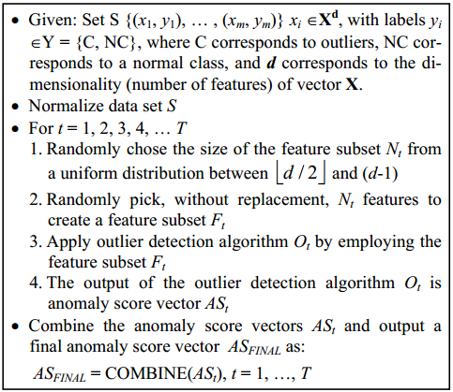
General framework for combining outlier detection techniques

Slide 13
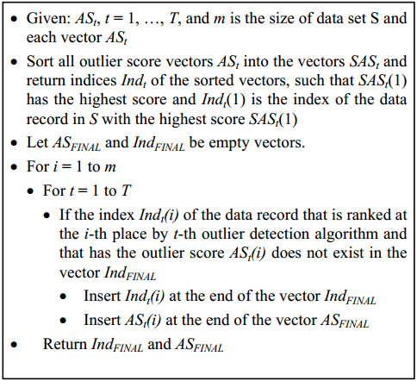
Breadth First approach

Slide 14
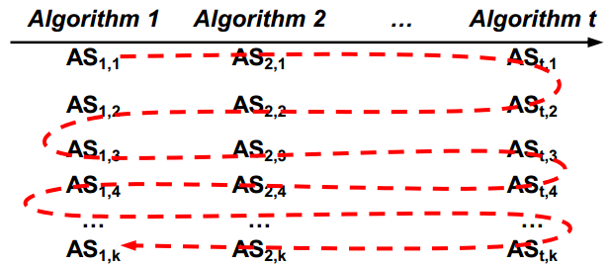
Breadth First approach

Slide 15
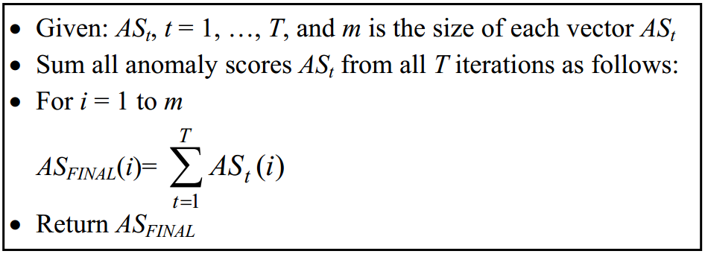
Cumulative Sum approach

Slide 16
主要内容
题目解释
要解决的问题
提出的方法
方法效果
个人想法

Slide 17
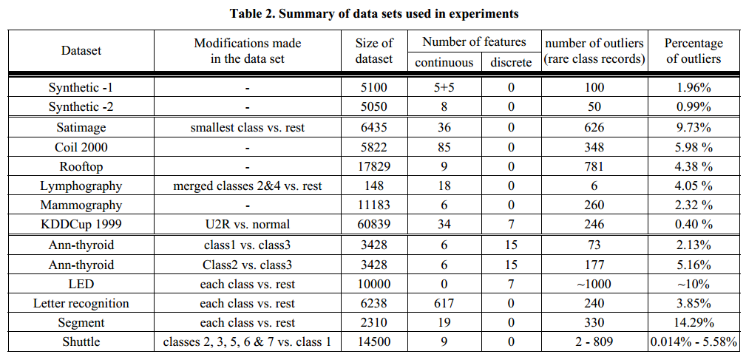
实验数据集

Slide 18
实验情况
If there are irrelevant features in the data sets, combining methods are able to decrease the influence of noisy features regarding the detection performance.
在所有feature都有贡献的时候，会比直接使用LOF差，毕竟每次迭代去掉了一些feature。
It can be observed that for all 66 real life data sets used in our experiments and for all values of false alarm rate, both combining methods were consistently better than the single LOF approach.

Slide 19
主要内容
题目解释
要解决的问题
提出的方法
方法效果
个人想法

Slide 20
一些个人想法
Feature Bagging 是让combining outlier detection algorithms有效果的主要原因，具体的结合方法的效果会因具体应用的情况而有所区别。
The set of features Ft is randomly selected from the original data set, such that the number of features in Ft is also randomly chosen between d/2 and (d-1), where d is the number of features in original data set.（为什么要定为这个大小范围？）
关于Breadth First approach：
受算法顺序影响较大（原文有提到）。
每个算法相同排名下的数据的地位真应该在同一层级的吗？是不是应该优先考虑分数方差较大的算法？
某个数据对象在一个算法中排名靠前，并与其他数据对象分数很接近，而在另一个算法中却比其他对象低很多，应该被认为是离群点吗？
在最终输出向量中，排前面的分数比后面的低该怎么处理？

Slide 21
一些个人想法
关于Cumulative Sum approach：
仅仅看分数可能会有问题。有些算法中所有数据的离群点分数都很低，但个别数据对象与总体的分数差距却又是大的，这种情况在每个算法等权重的设定下会被忽视。应该给离群点分数方差较大的算法加权重来应对这种情况。
综合3，4的一些想法，觉得该文章的方法对于不同情况的权重分配缺少考虑。

Slide 22
文章中的未来工作
Although performed experiments have provided evidence that the proposed methods can be very successful for the outlier detection task, future work is needed to fully characterize them especially in very large and high dimensional databases, where new algorithms for combining outputs from multiple outlier detection algorithms are worth considering. It would also be interesting to examine the influence of changing the data distributions when detecting outliers in every round of combining methods, employing not only the distance-based but also other types of outlier detection approaches.

